Slide 1
Cardiovascular Diseases Risk Prediction
By:
Shreya M.S

Slide 2
Table of contents
01
02
03
Introduction
Aim and Objectives
Data Description
04
05
06
Data Preprocessing
Exploratory data analysis
Conclusion and References
Elaborating the project topic
Key factors influencing to find the insights of CVD
Source/Size/Types of data used
Dataset load/checking for null values and many more
Visualization of the dataset in various forms.
Result of analysis and reference of data set

Slide 3
01
Introduction

Slide 4
OVERVIEW:
The Behavioral Risk Factor Surveillance System (BRFSS) is the nation’s premier system of health-related telephone surveys that collect state data about U.S. residents regarding their health-related risk behaviors, chronic health conditions, and use of preventive services. This dataset contains health checkup status, their history related to exercise and their consumption of healthy and unhealthy foods and habits including their age, height, weight, BMI.
BRIEF DESCRIPTION:
The analysis will help us go through the type of gender that is present in the CVD dataset and the age group that is responsible for the some health conditions and the types of diseases taking place along with finding the frequency of the fruit consumption and exercise and helps alot in gaining deep insights about the people health and helps to take preventive measures as well.

Slide 5
02
Aim and Objectives

Slide 6
AIM:
To build a machine learning model that predicts the likelihood of diseases such as heart disease, skin cancer, diabetes, and other health conditions based on features such as general health status, checkup frequency, exercise habits, and other health-related factors.
OBJECTIVE:
The objective of this project is to build a machine learning model to predict the likelihood of diseases like heart disease, diabetes, and skin cancer based on health and lifestyle factors. The process involves cleaning and preparing the data, selecting key features, and training a classification model. The model's performance will be evaluated using accuracy and other metrics, aiming to provide a reliable tool for early disease prediction and healthcare decision-making.

Slide 7
03
Data Description

Slide 8
Stats software and data sources
Source
Jupyter notebook
The data was sourced from the BRFSS and CDC(2021)
dataset which was taken from Kaggle.
is a interactive computing software across multiple programming languages

Slide 9
5,032 rows.
19 columns.
3,567 active diseases.
Data analysis Description
Dataset Size:

Slide 10
Data Types
Target Variable
Catergorical:General_Health,Checkup,Exercise,
Heart_Disease,Skin_cancer, Other_Cancer, Depression, Diabetes, Arthritis, Sex, Age_Category, Smoking_History.
Numercial: Height_(cm),Weight_(kg),BMI,Alcohol_
Consumption,Fruit_Consumption,Green_Vegetables_Consumption,FriedPotato_Consumption.
The primary target variable is General_Health.

Slide 11
Key values(Columns):
General_Health – General health status (e.g., Poor, Very Good, Good). | Other_Cancer – History of other cancers (Yes/No). | Age_Category – Age group of the individual (e.g., 60-64, 70-74). | Alcohol_Consumption – Alcohol consumption rate (measured in units).
Checkup – Time since the last medical checkup (e.g., Within the past year, Within the past 2 years). | Depression – Depression status (Yes/No). | Height_(cm) – Height of the individual in centimeters. | Fruit_Consumption – Rate of fruit consumption (measured in units).
Exercise – Whether the individual exercises (Yes/No). | Diabetes – Diabetes status (Yes/No). | Weight_(kg) – Weight of the individual in kilograms. | Green_Vegetables_Consumption – Rate of green vegetable consumption (measured in units).
Heart_Disease – Whether the individual has heart disease (Yes/No). | Arthritis – Arthritis status (Yes/No). | BMI – Body Mass Index, calculated based on height and weight. | FriedPotato_Consumption – Rate of fried potato consumption (measured in units).
Skin_Cancer – History of skin cancer (Yes/No). | Sex – Gender of the individual (Male/Female). | Smoking_History – Smoking history (Yes/No).

Slide 12
04
Data Preprocessing

Slide 13
Data Preprocessing Steps
Load The
Dataset
Data
Exploration
Removing Duplicates/
Handling Outliers
Data information
and description
Handling missing
Values
Description of Other Factors

Slide 14
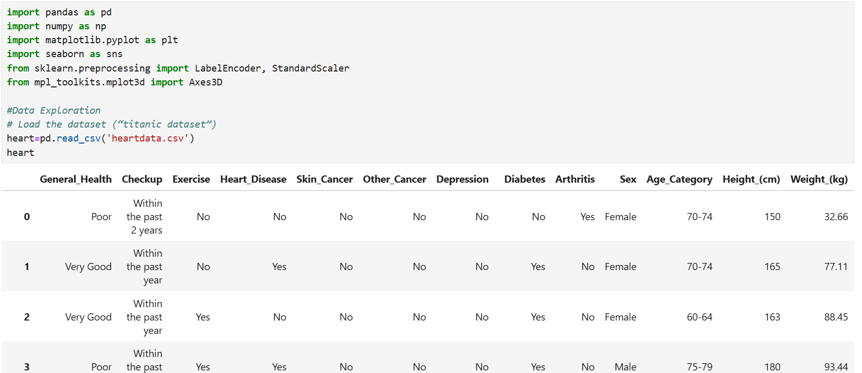
Loading the dataset:
The dataset named “heartdata” contains key variables that affect CVD data analysis, setting the stage for comprehensive analysis.

Slide 15
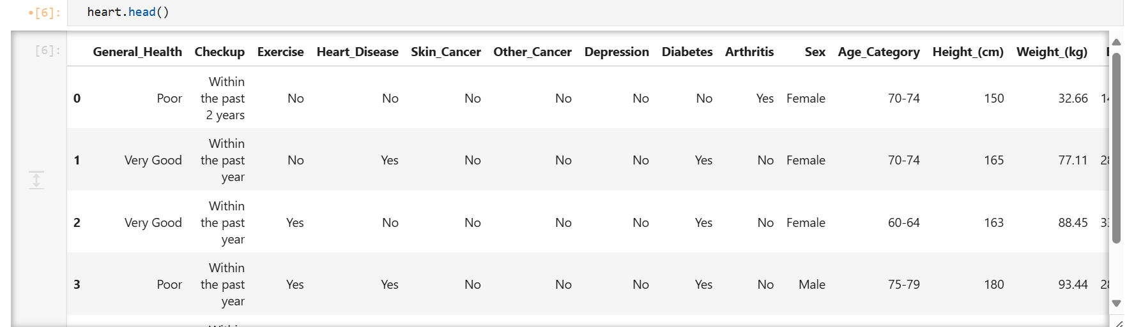
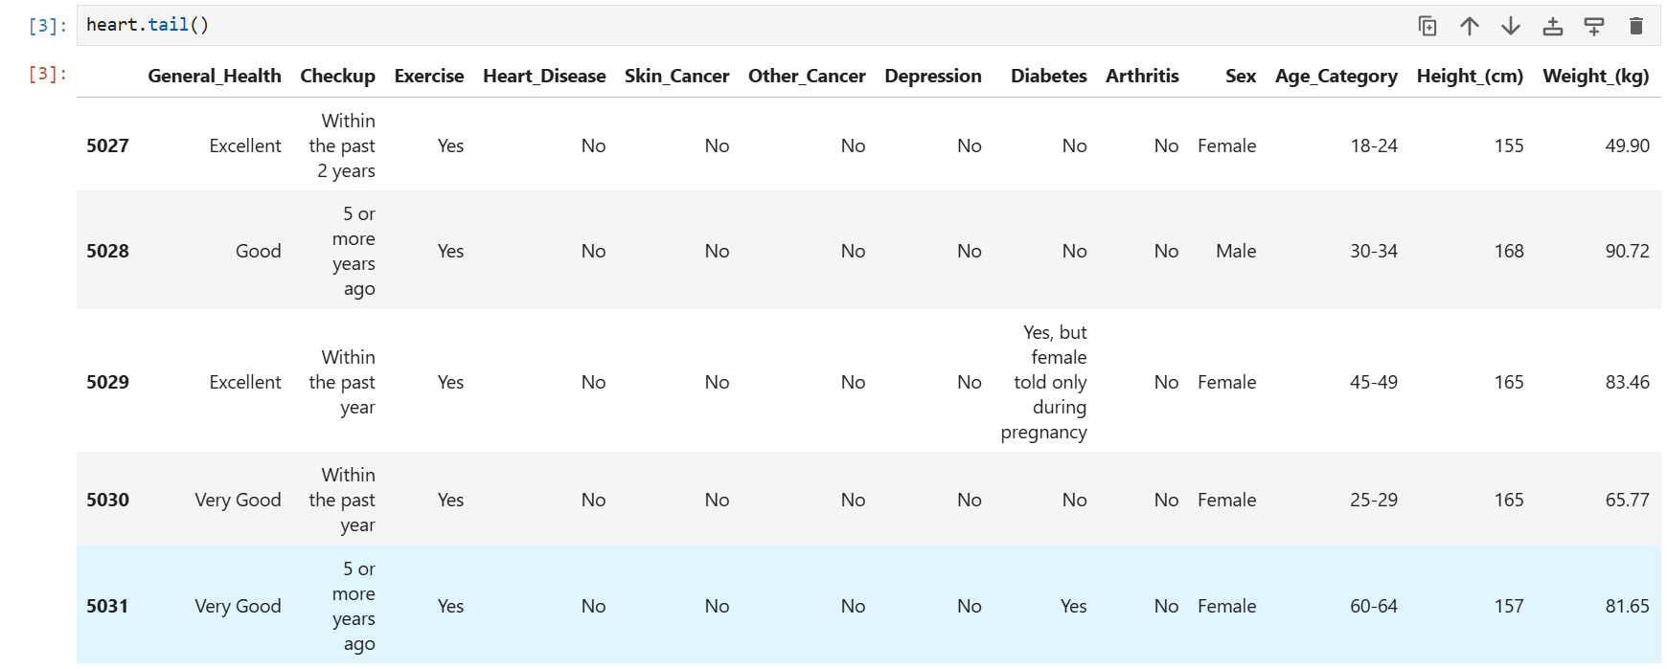
Data Exploration:

Slide 16
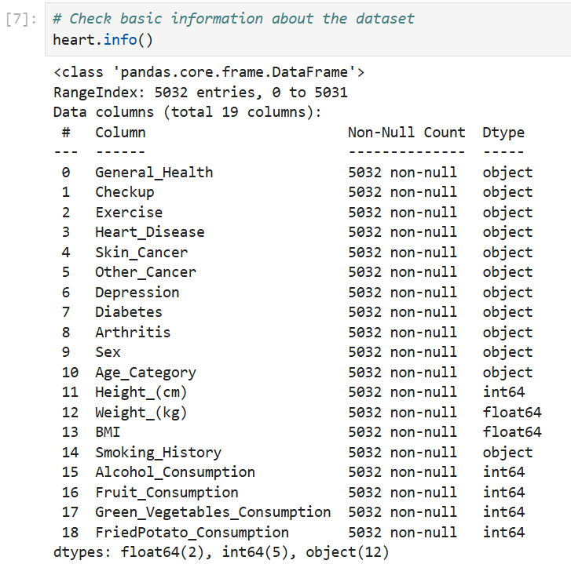
Info() :

Slide 17
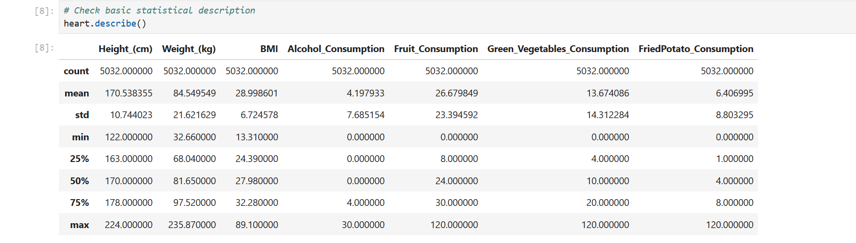
Describe():

Slide 18
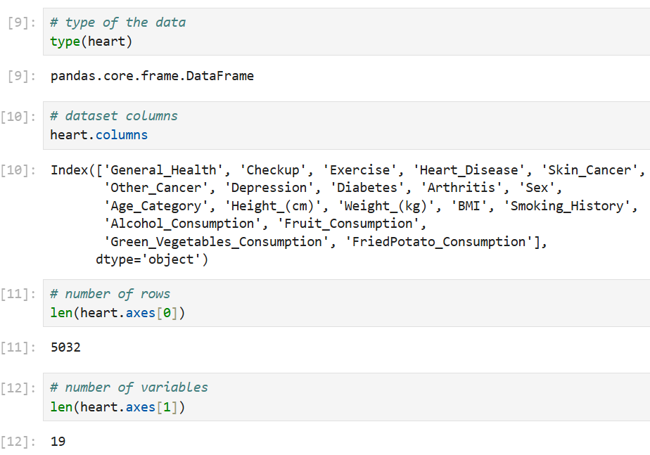
Description of other factors:

Slide 19
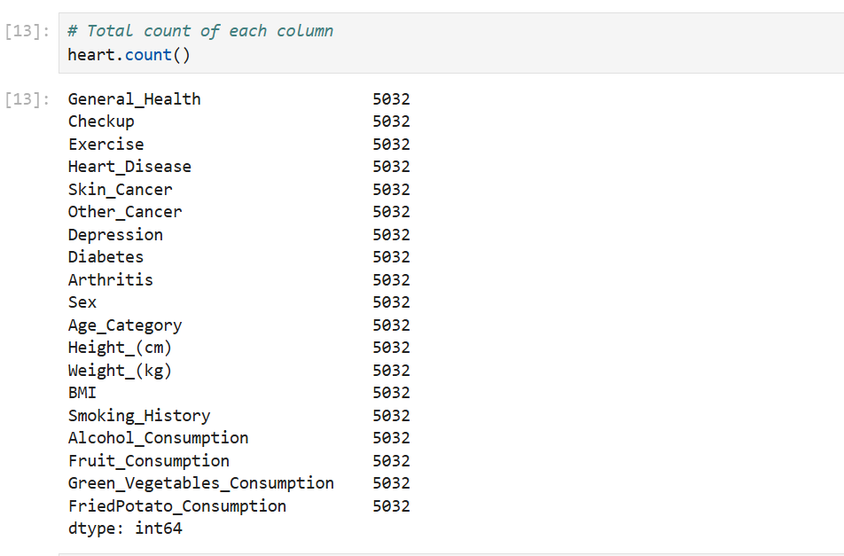

Slide 20
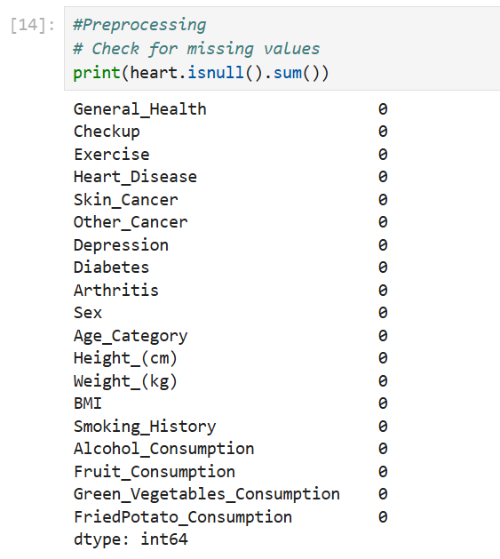
Handling Missing Values:
As you can see there is no null data values in the data set. There is no need of handling missing value.

Slide 21
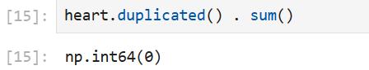
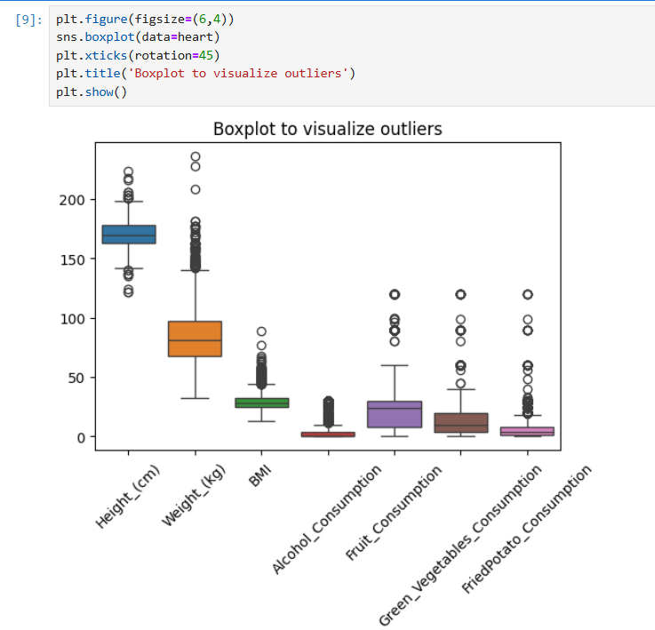
Removing Duplicates- Checked for duplicate rows in the dataset using the duplicated() function. Duplicate rows were removed to ensure data quality.
Handling Outliers- Outliers were visualized using a box plot for the entire dataset.

Slide 22
05
Exploratory Data Analysis.

Slide 23
Exploratory data analysis types
Multivariate
Univariate
Bivariate

Slide 24
Exploratory data analysis types
Univariate
Bivariate
Multivariate

Slide 25
Exploratory data analysis types
Bivariate
Multivariate
univariate

Slide 26
Univariate Analysis:
This type of analysis focuses on a single variable, examining its distribution, central tendency, and variability. It helps summarize data by providing measures like mean, median, mode, and standard deviation, helping to understand individual characteristics without considering relationships with other variables.
Bivariate Analysis:
Bivariate analysis examines the relationship between two variables. It explores how one variable changes in response to another, typically using techniques like correlation, regression, and scatter plots. This helps in understanding associations, trends, and potential causal relationships between two datasets
Multivariate Analysis:
Multivariate analysis involves examining the relationships between multiple variables simultaneously to understand their effects and interactions

Slide 27
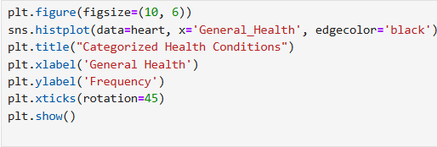
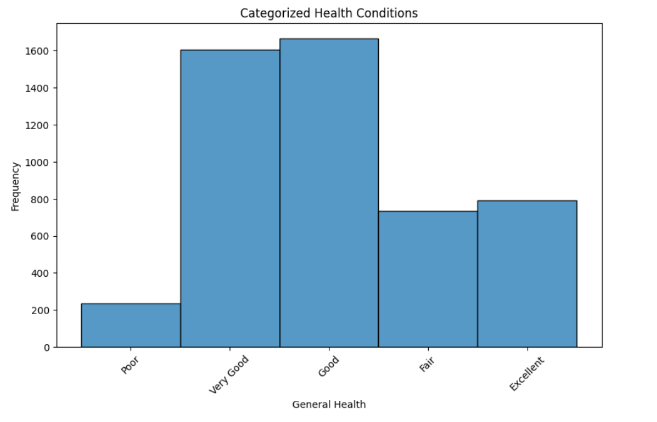
Univariant Analysis
Data Visualization:
This hist plot displays the distribution of the general health categories that shows overal peoples health status.
Fig: Univariant analysis of general health

Slide 28
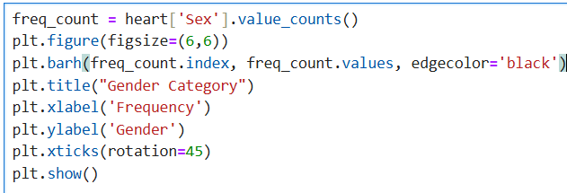
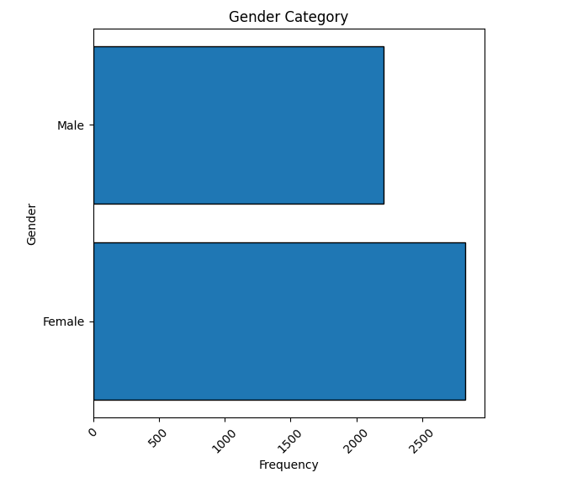
This horizontal bar plot represents the total number of male and females in dataset who have been through health checkups.

Slide 29
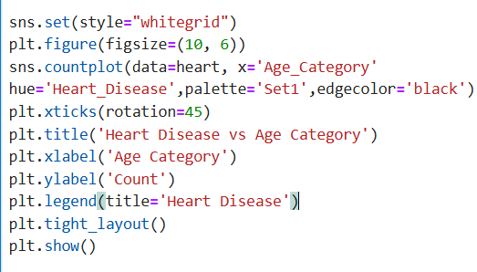
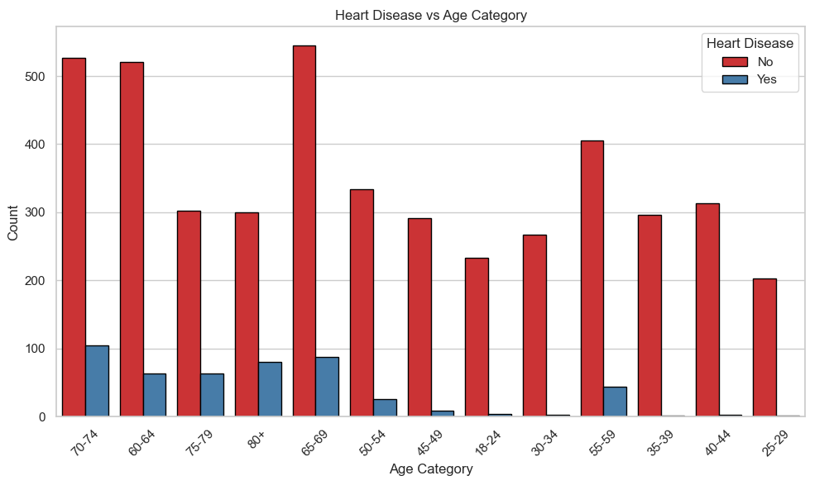
Bivariant Analysis
This countplot shows the analysis between heart disease and age category.
Fig: Age group falling between 19 to 25

Slide 30
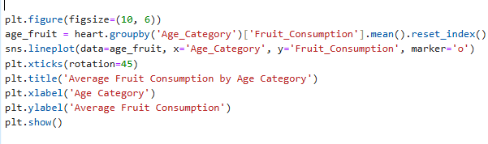
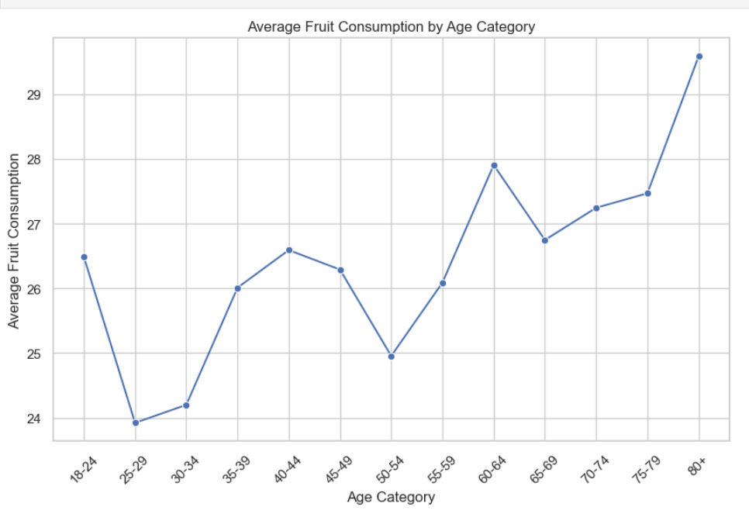
This lineplot shows the graphical representation of average of fruits consumed by people as according to the age categ

Slide 31
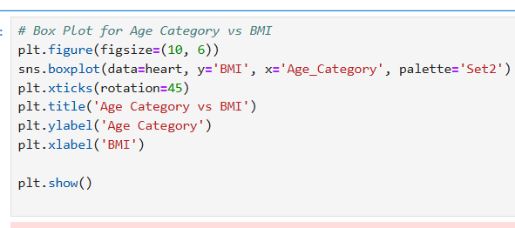
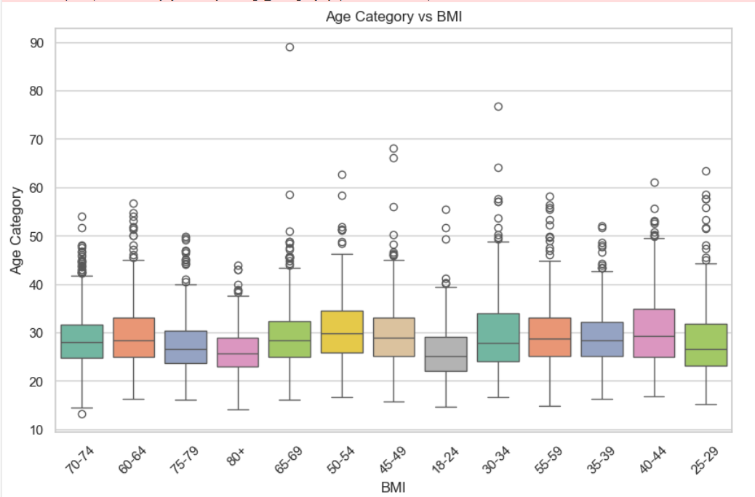
This Boxplot shows the graphical representation of age of people with BMI.

Slide 32
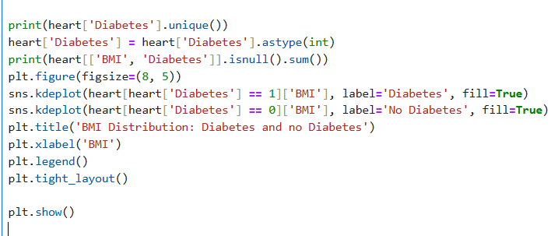
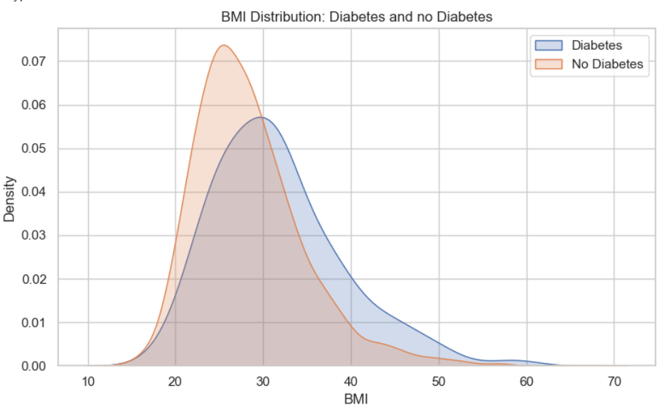
In this density plot here we can see the ratio of people having heart attack and with their body mass index.

Slide 33
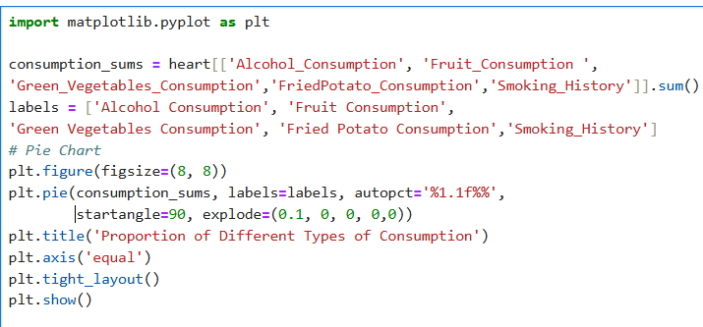
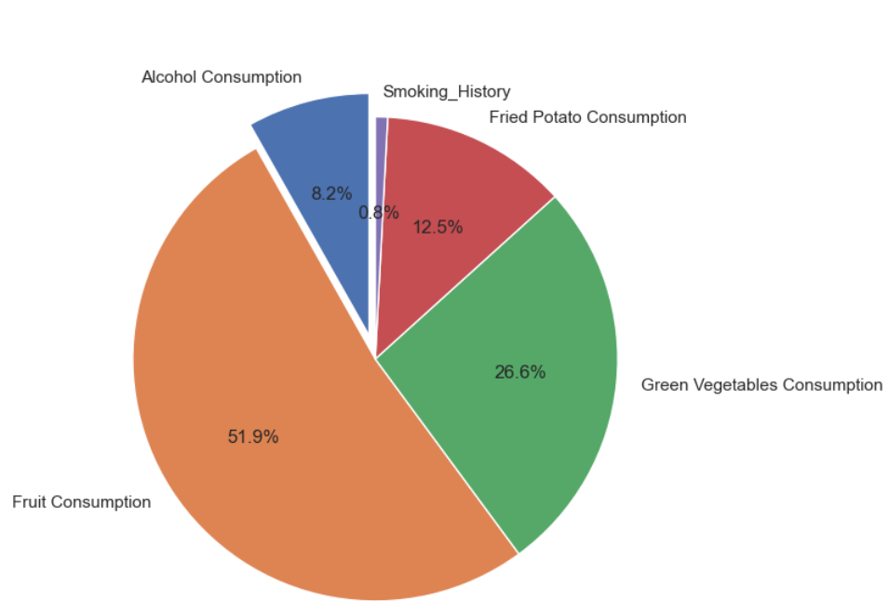
Multivariant Analysis
This pie chart shows the percentage ratio of several columns like consumption of alchohol,fried potato, vegetables and smoking history.
Fig:3D Scatter plot of crime Data

Slide 34
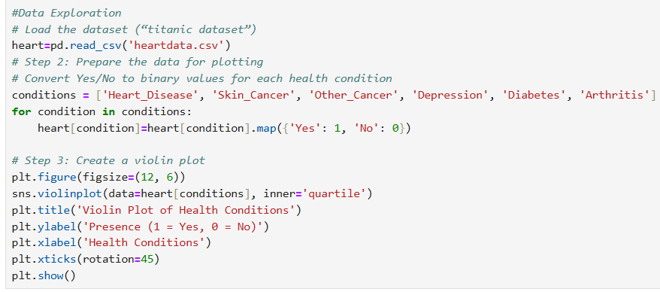
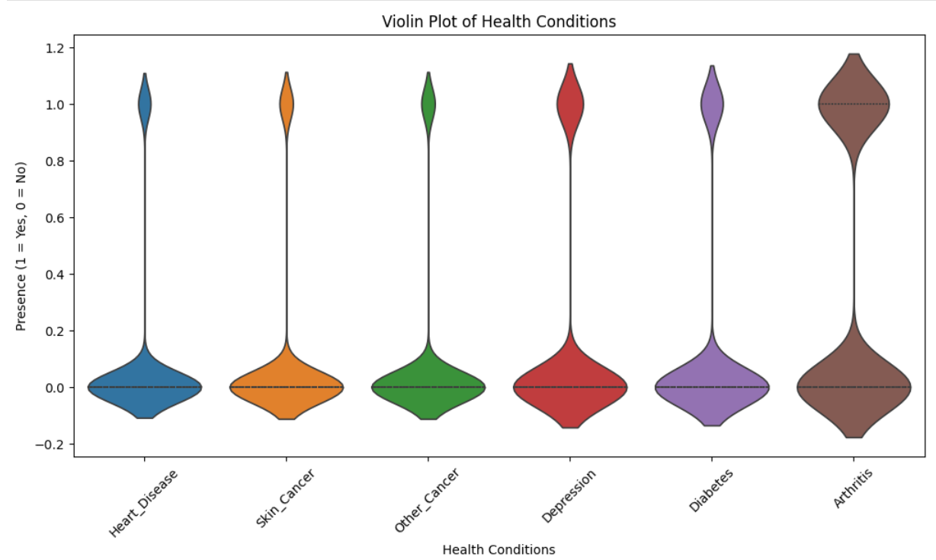
This violin chart shows the overall percentage of consumption of alchohol,fried potato, vegetables and smoking history.

Slide 35
Machine Learning
Machine learning algorithms are computational methods that enable systems to learn from data, identify patterns, and make decisions or predictions without being explicitly programmed, allowing for automation and enhanced insights across various domains such as finance, healthcare, and education.
In this analysis, categorical variables are converted into numerical formats using Label Encoder to facilitate their inclusion in a linear regression model.
The dataset is split into training and testing sets, with a linear regression model trained on the training data.
The model's performance is evaluated using the R² score and Mean Squared Error (MSE), providing insights into its predictive accuracy.
This structured approach ensures that the model is effectively trained and assessed, laying the groundwork for further educational data analysis.

Slide 36
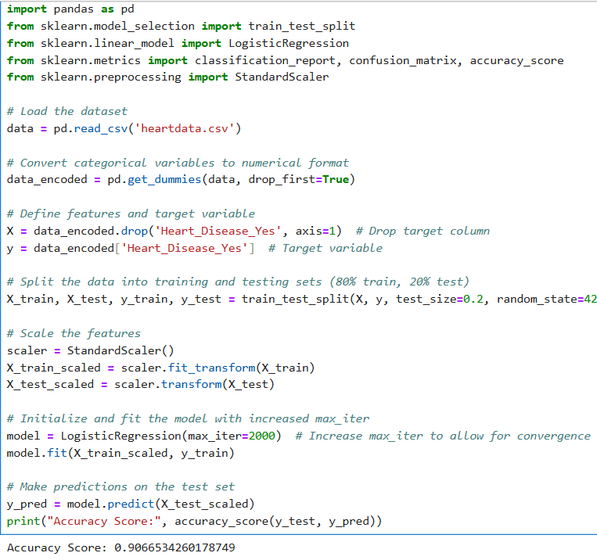

Slide 37
Conclusions
The cardio vascular disease dataset provides insights into how various health and lifestyle factors influence the likelihood of heart disease and other health conditions.
Dietary Habits: While not the most significant predictors on their own, dietary factors like fruit and vegetable consumption may have indirect effects on heart health, especially when combined with exercise habits and weight.
Individuals reporting poor or fair health are more likely to have heart disease, highlighting the importance of overall wellness.
Smoking and Alcohol Consumption: These behaviors, especially smoking, are associated with a higher likelihood of heart disease and other cancers. Reducing these habits can have a positive impact on heart health.
Age: Older age groups, particularly those above 60, show a higher prevalence of such disease. This aligns with the fact that age is a major risk factor for cardiovascular conditions.

Slide 38
Future scope:
More Comprehensive Health Data: Incorporating additional health metrics such as cholesterol levels, blood pressure, or genetic information could improve predictive accuracy.
Balanced Dataset: If the dataset is imbalanced (more "No" than "Yes" for heart disease), techniques like oversampling or balancing the data may improve model performance.
Feature Engineering: Creating new features, such as physical activity frequency or diet quality scores, could improve the models by capturing more subtle relationships between lifestyle factors and heart health.

Slide 39
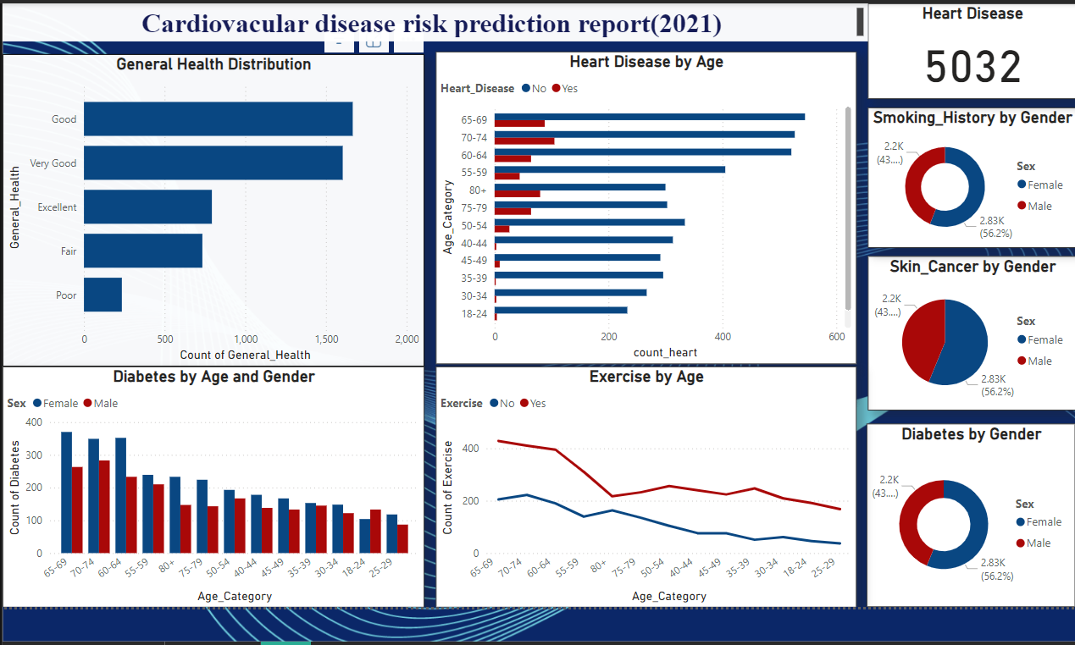
Dashboard
Here’s a detailed dashboard providing key insights into heart health trends and risk factors.

Slide 40
References
Dataset: Kaggle. Cardiovascular disease risk prediction dataset. The data was sourced from the BRFSS and CDC(2021) https://www.kaggle.com/datasets/cvd
Data Preprocessing Techniques. (n.d.): Guidelines and methodologies for handling missing values, outliers, and categorical variables in datasets. Retrieved from https://towardsdatascience.com/data-preprocessing-techniques-in-machine-learning-with-python-9f3c42e45231
Machine Learning Algorithms. (n.d.). Overview of algorithms used for predictive modeling in education, focusing on their applications to improve cvd predictions. Retrieved from https://www.geeksforgeeks.org/machine-learning-algorithms/
Statistical Software Documentation. (n.d.). User manuals and online resources for tools like Python, Pandas, and Seaborn, essential for data analysis and visualization. Retrieved from https://www.youtube.com/watch?v=vmEHCJofslg (Corey Schafer's Python Pandas Tutorial).

Slide 41
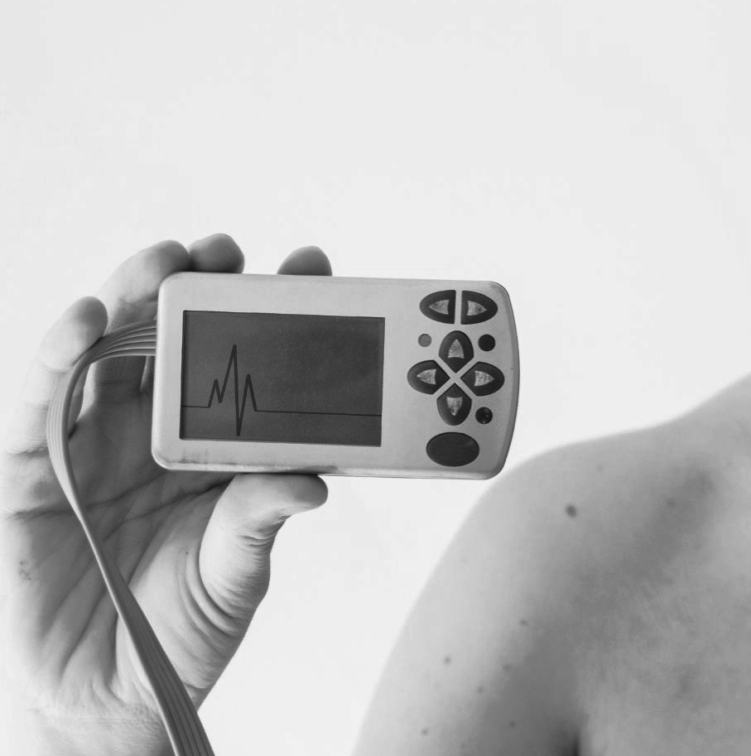
An Article about this dataset.
.

Slide 42
Thank Youuu…!

